Slide 1
CLOUD COMPUTING
Intelligent storage
for Image Classification
MANSI BELLANI 07
KHUSHI BHATIA 08
MUSKAN CHHABRIA 13
SHUBHAM GUPTA 21

Slide 2
Table of contents
INTRODUCTION
Literature Survey
Overview
Azure Services
METHODOLOGY
BLOCK DIAGRAM
CONCLUSION
Introduction to the Intelligence Storage Project
Literature survey of current existing systems
Overview of the Project
Detail description of Azure services used
Various methods used for project
Diagrammatic explanation of working
Conclusion of the project

Slide 3
INTRODUCTION
Image classification is a critical task in various domains such as healthcare, security, entertainment, and more.
An intelligent storage system for image classification can help manage image data efficiently, enabling faster and more accurate image classification.
In this project, we aim to create an intelligent storage system for image classification that uses Azure services.

Slide 4
LITERATURE SURVEY
Title | Inference Drawn
Research on Cloud Data Storage Technology and Its Architecture Implementation | The paper discusses the architecture of cloud storage systems and various technologies used, such as distributed file systems, object storage, and block storage. The paper also highlights the advantages and disadvantages of these technologies and their respective use cases. Furthermore, the paper identifies the challenges faced by cloud storage systems and potential future research directions, such as improving data security and privacy, enhancing system scalability and reliability, and developing more efficient data management and analysis techniques. Overall, the paper provides a comprehensive overview of cloud storage technology and its implementation, making it a valuable resource for researchers and practitioners in the field of cloud computing and storage.
A Study on Information Classification and Storage in Cloud Computing | The paper proposes a group collaborative intelligent clustering approach to classify and store data in cloud computing data centers. The paper also discusses the benefits of this approach, including improved data security, accessibility, and reliability. Furthermore, the paper identifies the challenges faced by cloud computing data centers and suggests future research directions, such as optimizing the clustering algorithm and improving the performance of data storage systems. Overall, the paper provides insights into the classification and storage of information in cloud computing data centers, making it a valuable resource for researchers and practitioners in the field of cloud computing.

Slide 5
OVERVIEW OF PROJECT
Our project consists of several key components:
Data Collection: We will collect a dataset of images that will be used to train and test our machine learning model. We will store the images in Azure Blob Storage.
Preprocessing: We will preprocess the images to ensure that they are in a format that can be used by our machine learning model. This may include resizing, cropping, and converting the images to grayscale. We will use Azure Functions to perform this step.
Machine Learning Model Training: We will train a machine learning model to classify the images. We will use Azure Machine Learning to train the model.
Deployment: Once the model is trained, we will deploy it using Azure Functions. This will allow us to run our code without managing the underlying infrastructure.
Result Storage: We will use Azure Blob to store the results of the image classification. This will allow us to easily access and analyze the results.

Slide 6
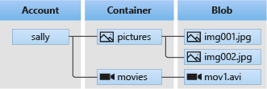
AZURE SERVICES USED
Azure Blob Storage for Image Storage : Blob Storage is optimized for storing massive amounts of unstructured data. Unstructured data is data that doesn't adhere to a particular data model or definition, such as text or binary data.
Blob Storage is designed for:
Serving images or documents directly to a browser.
Storing files for distributed access.
Streaming video and audio.
Writing to log files.
Storing data for backup and restore, disaster recovery, and archiving.
Storing data for analysis by an on-premises or Azure-hosted service.
Blob Storage offers three types of resources:
The storage account : Provides a unique namespace in Azure for our data.
A container in the storage account : Organizes a set of blobs, similar to a directory in a file system, storage account can include an unlimited number of containers, and a container can store an unlimited number of blobs.
A blob in a container : It has 3 types of blobs -
Block blobs store text and binary data.
Append blobs are more optimized for append operations, They are ideal for scenarios such as logging data from virtual machines.
Page blobs store random access files up to 8 TiB in size, It stores VHD files and serve as disks for Azure virtual machines.

Slide 7
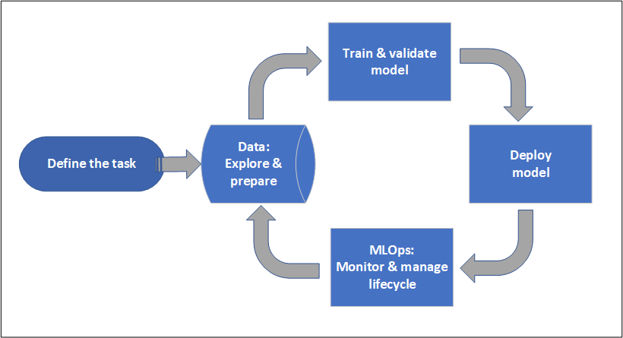
AZURE SERVICES USED
Azure Machine learning : We can create a model in Azure Machine Learning or use a model built from an open-source platform, such as Pytorch, TensorFlow, or Scikit-learn. MLOps tools help us monitor, retrain, and redeploy models.
Typically models are developed as part of a project with an objective and goals. Projects often involve more than one person. When experimenting with data, algorithms, and models, development is iterative.
Project lifecycle -

Slide 8
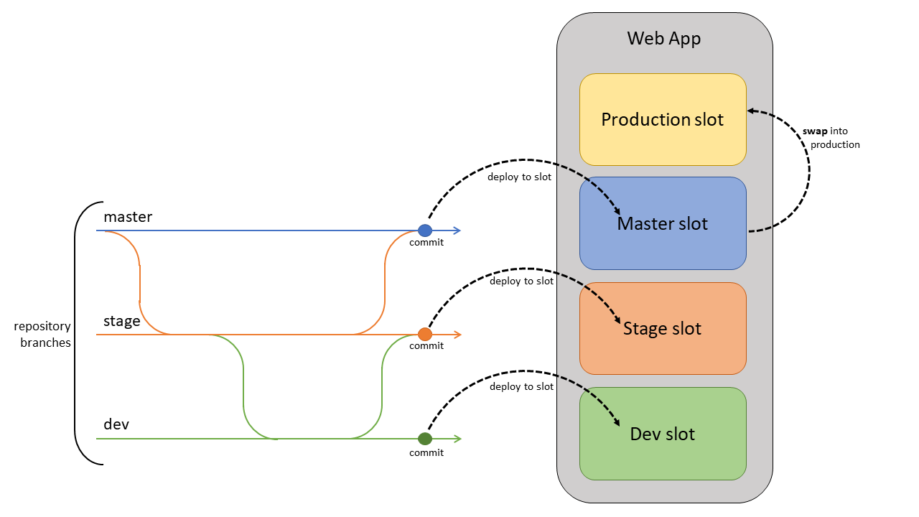
AZURE SERVICES USED
Web app Service for deployment :
We can create a web app using Azure portal, VS Code, Azure Tools extension pack, or Azure CLI.
The steps involved in deploying a web app to Azure App Service:
Sample Application
Create a web app in Azure
Deploy your application code to Azure
Browse to the app
Stream logs

Slide 9
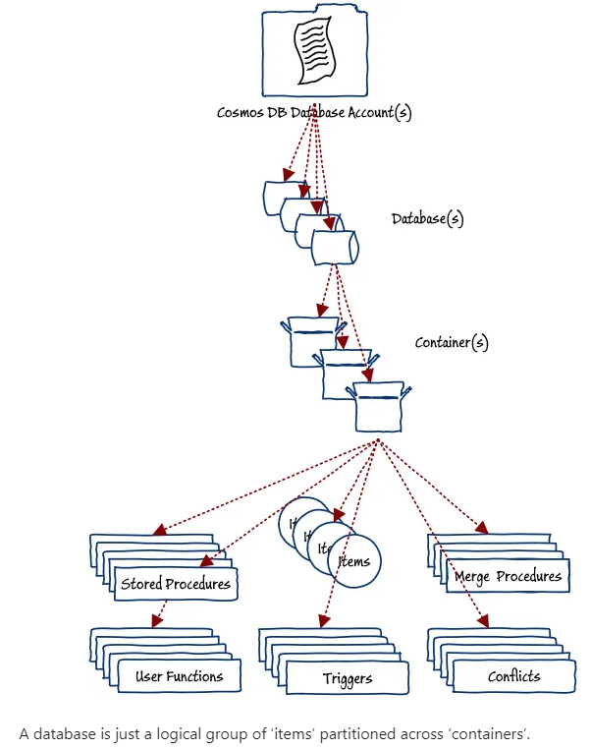
AZURE SERVICES USED
Azure Cosmos DB:
It is fully managed NoSQL and relational database which is is a globally distributed, multi-model database service provided by Microsoft Azure that is designed to handle large amounts of structured, semi-structured, and unstructured data.
It takes database administration off our hands with automatic management, updates, and patching. It also handles capacity management with cost-effective serverless and automatic scaling options that respond to application needs to match capacity with demand.
The process for using Cosmos DB typically involves the following steps:
Create a Cosmos DB account
Choose a data model
Create a database and containers
Write data to your database
Monitor and optimize performance

Slide 10
METHODOLOGY
Collect and preprocess the image data using Azure Blob Storage and Azure Functions.
Train the machine learning model using Azure Machine Learning.
Deploy the machine learning model using Azure Functions.
Store the results of the image classification using Azure CosmoDB storage.
Monitor the system using Azure Monitor to ensure that it is running smoothly using Azure cloud monitoring service which supports the operations at scale by helping us to maximize the performance and availability of our resources and proactively identify problems.

Slide 11
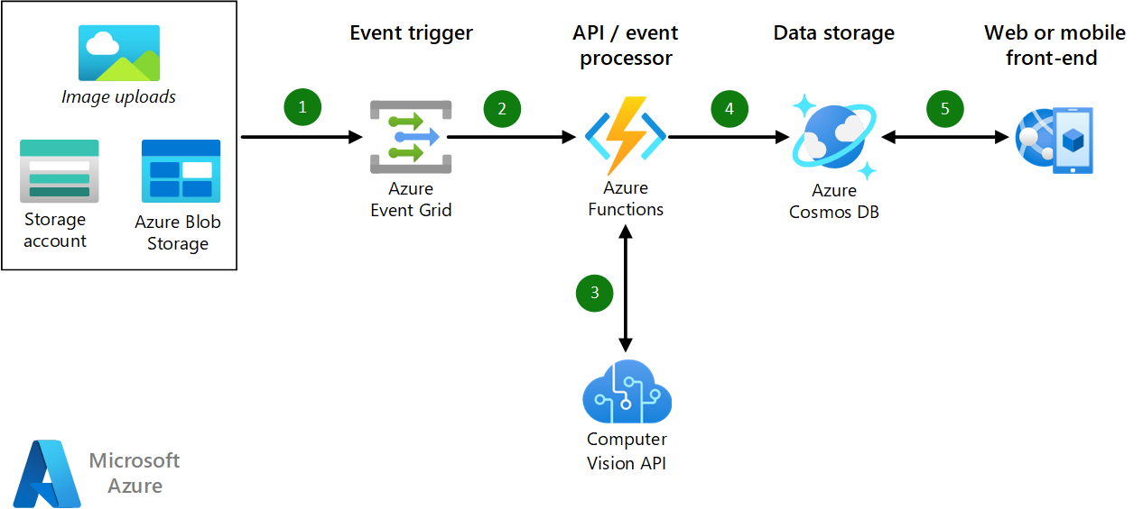


BLOCK DIAGRAM

Slide 12
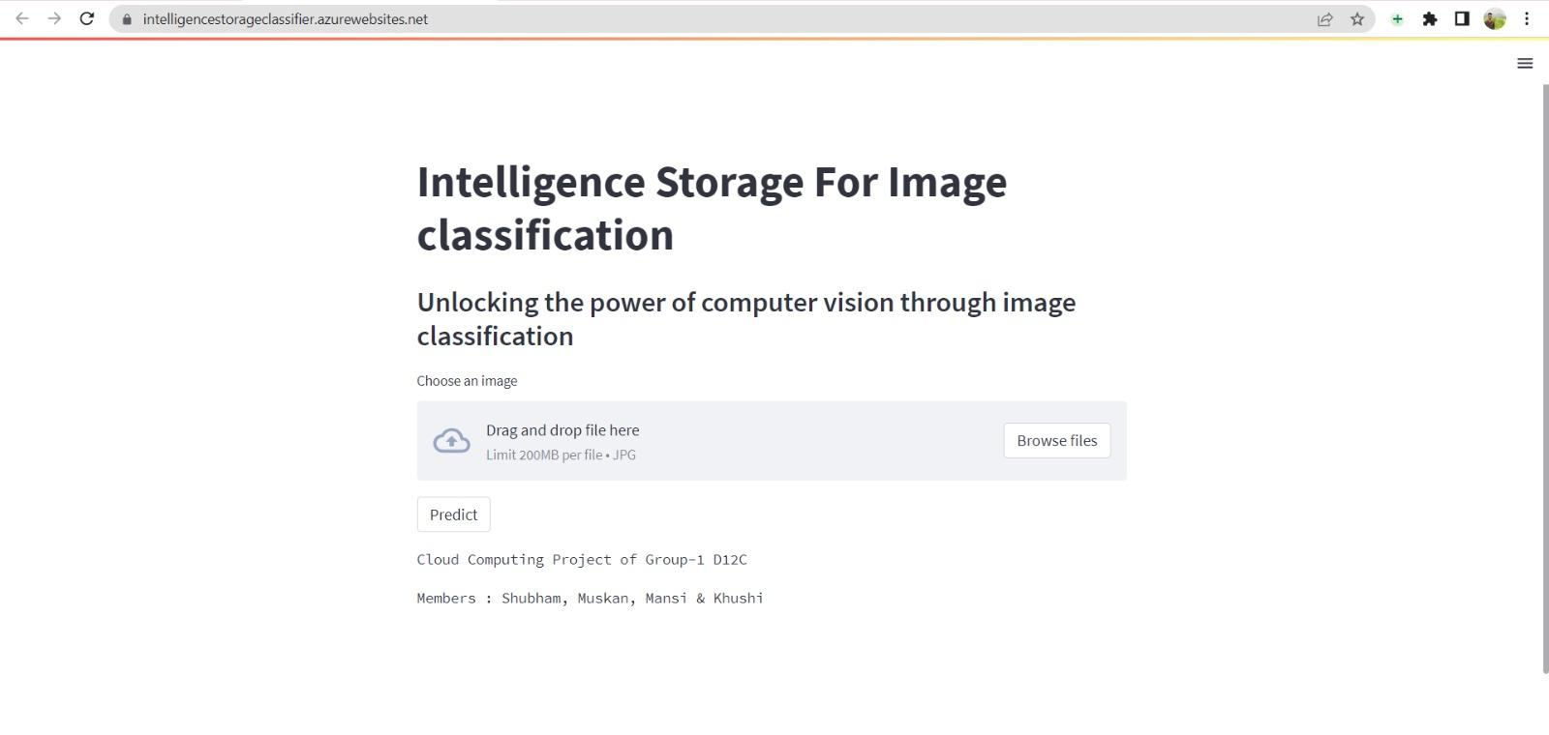
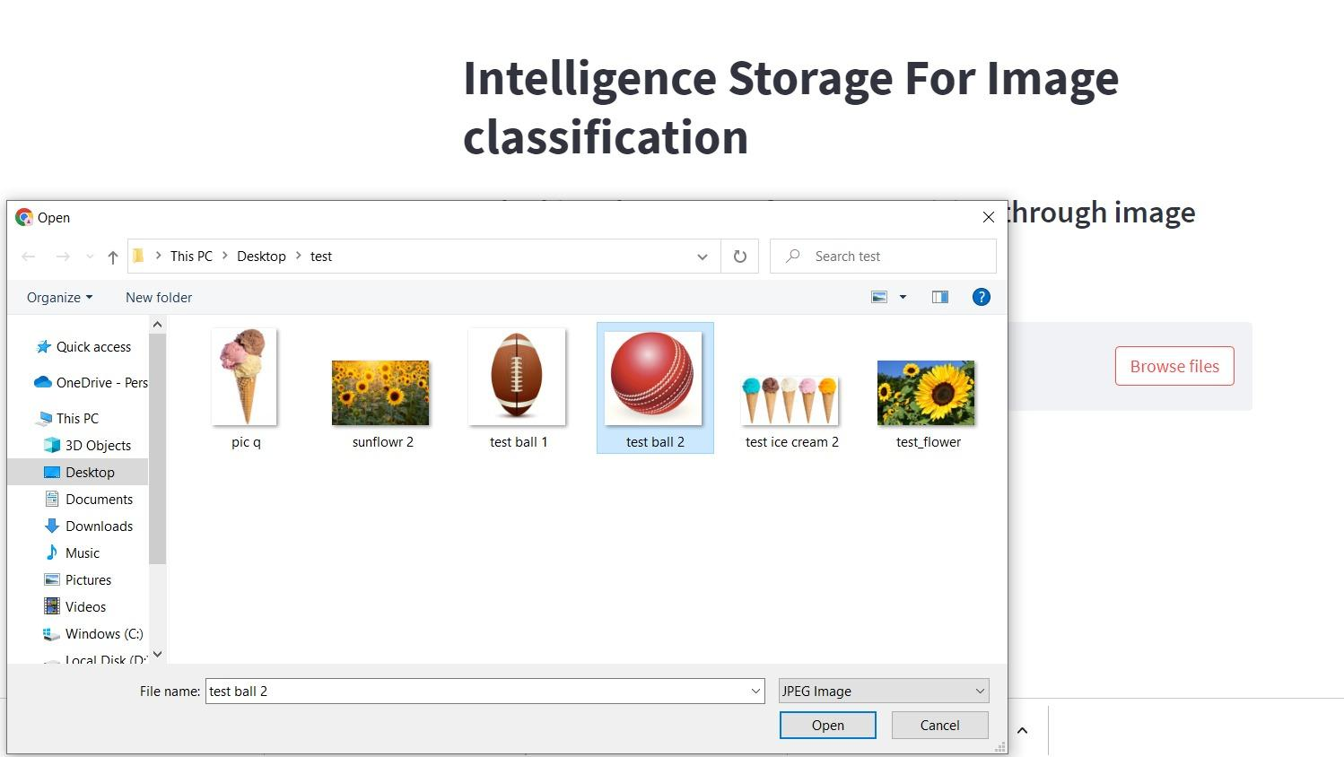
IMPLEMENTATION & RESULT
Front-end of project Deployed on Azure web service based on predicting flower, ball and icecream.
Uploading image for classification.

Slide 13

IMPLEMENTATION & RESULT
Output of uploaded image and the classification is done using Support Vector Machine Algorithm (SVM)

Slide 14
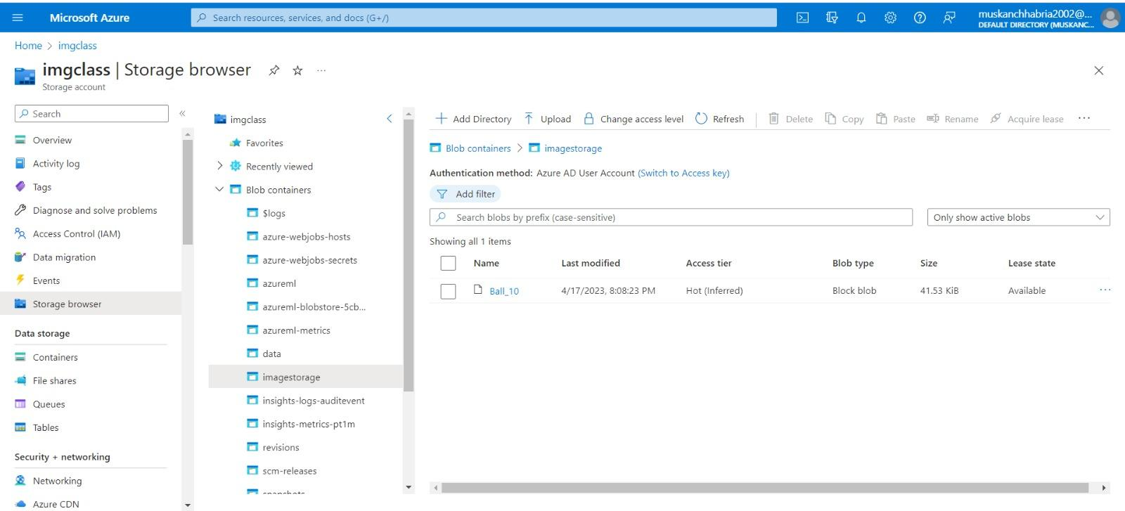
IMPLEMENTATION & RESULT
Image stored in Blob storage

Slide 15
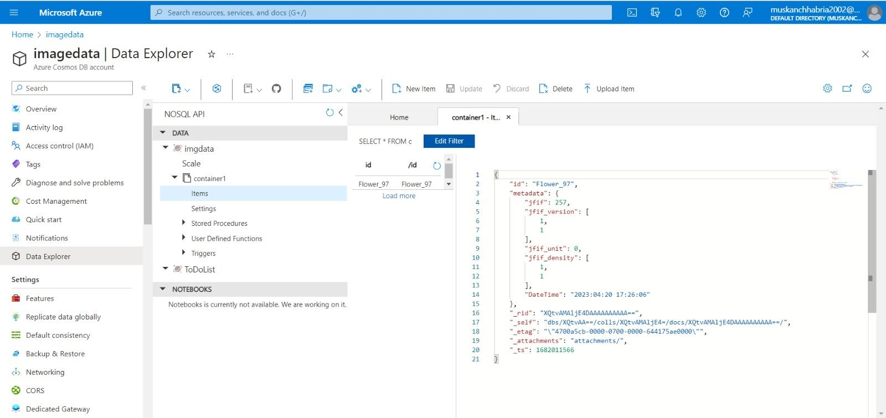
IMPLEMENTATION & RESULT
Metadata of image stored in CosmoDB, Storing Timestamp and Result

Slide 16
CONCLUSION
In conclusion, an intelligent storage system for image classification can help manage image data efficiently, enabling faster and more accurate image classification. By using Azure services for data collection, preprocessing, machine learning model training, deployment, and result storage, we can create a robust and scalable system for image classification.

Slide 17
REFERENCES
Research Papers:-
Research on Cloud Data Storage Technology and Its Architecture Implementation
A Study on Information Classification and Storage in Cloud Computing
Websites:-
https://learn.microsoft.com/en-us/azure/machine-learning/v1/tutorial-train-deploy-notebook?view=azureml-api-1
https://learn.microsoft.com/en-us/azure/event-grid/resize-images-on-storage-blob-upload-event?tabs=dotnet%2Cazure-powershell
https://www.hindawi.com/journals/jece/2022/1476661/

Slide 18
THANK YOU!

